Slide 1
Persistence Layer using Spring Boot

Slide 2
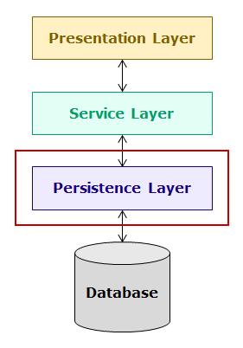
Introduction to Persistence Layer
The persistence layer interacts with relational database and the service layer. It gets data from service layer, performs operations on database and sends back results to service layer. The code to interact with database is implemented in this layer. In this course, you will learn development of persistence layer using Spring ORM and Spring Data.

Slide 3
In this course, you will understand the concepts of persistence layer by developing a banking application named hndBank containing multiple modules. One of the modules of this application is Customer module which has the following functionalities:
Add customer
Edit customer details
View all customers
Delete customers
You will develop the Customer module of this application using multi-tiered architecture as shown below:

Slide 4
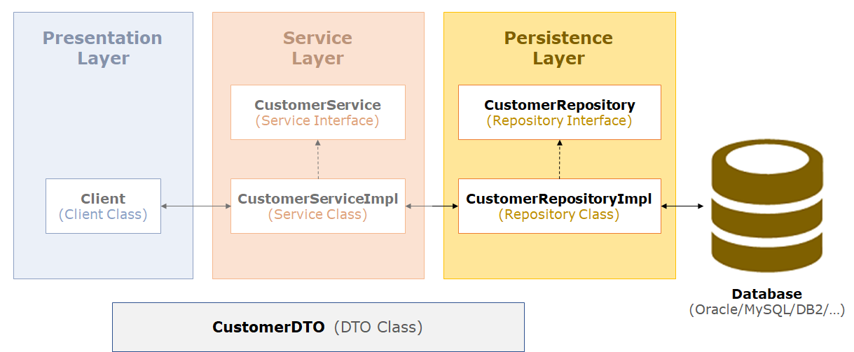

Slide 5
For better understanding, we have considered only Repository implementation to explain the concepts.
Spring is a popular framework for enterprise application development. For implementing persistence layer, it provides many approaches. The developer can choose appropriate Spring modules such as Spring JDBC or Spring ORM to integrate with JPA, Hibernate etc. for implementing the data access layer of an enterprise application.
Spring further simplifies development of persistence layer using Spring Data, which is an umbrella project supporting both relational and non-relational databases effectively. It provides a consistent persistent layer code with minimal coding from the developer thereby eliminating a lot of developer effort.
In this course, you will learn how to develop persistence layer of an application using
Spring ORM
Spring Data
Spring JDBC (refer to appendix)
Now let us start learning Spring ORM.

Slide 6
Object Relational Mapping
You already know how to use JDBC for developing persistence layer of an application. The JDBC code involves both Java objects (object model) and SQL queries (relational model). This makes it difficult to use because object model needs to be converted to relational model and vice versa. For example, for executing SQL select query the values present in Java object needs to be copied into SQL query but this conversion is not easy because of paradigm mismatch between object and relational model. This paradigm mismatch is called as Object-Relational Impedance Mismatch and it exposes following problems :
Problem of Granularity
This problem is that in object model, data can be present in more than one object but in relational model it is present in one table, i.e the object model is more granular than the relational model. For example, in object model you can have two separate classes, one for customer and the other for his address but in relational model, data about customer and his address can be stored in single table as shown below:

Slide 7
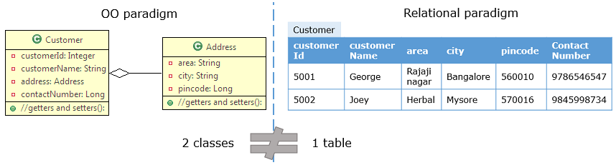
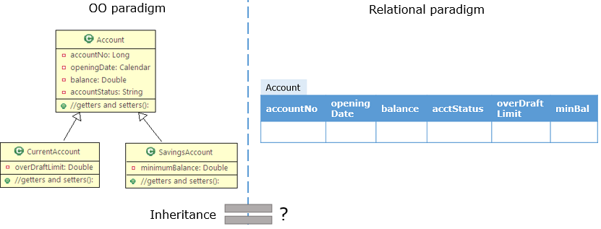
Problem of Inheritance
This problem is that in object model, you can create classes having inheritance relationship but in relational model there is nothing that can define inheritance.

Slide 8
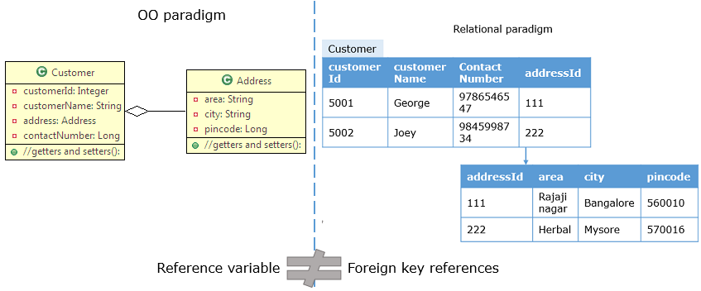
Problem of Identity
This problem is that the way in which equality of two objects is defined in object model is different for the way equality of two rows of a table is defined in relational model. For example, two rows in a table are same if they have same primary key values but two Java objects are equal if equals() method returns true.
Problem of Associations
This problem is that in object model, associations between objects is represented using references but in relational model, associations between tables is represented by foreign keys. Also, associations between objects can be unidirectional or bidirectional. However, in associations between tables there is no way to store information about directionality of relationship.

Slide 9
Problem of Data Navigation
This problem is that the way you access data in object model is different from the way you do it in a relational database. For example, in Java you navigate across association relationships using dot(.) operator but in relational model you navigate across related tables using joins.
To handle these problems, a technique called as Object-Relational Mapping (ORM) was introduced. It handles object relational impedance mismatch by providing a way to map Java objects to tables so that object model can be automatically translated to relation model and vice versa, allowing developers to focus only on the object model.
Now let us learn about ORM in detail.

Slide 10
Object Relational Mapping (ORM) is a technique or design pattern, which maps an object model with the relational model. It has the following features:
It resolves object-relational impedance mismatch by mapping
Java classes to tables in the database
Instance variables to columns of a table
Objects to rows in the table
It helps the developer to get rid of SQL queries so that they can concentrate on the business logic which leads to faster development of the application.
It is database independent. All database vendors provide support for ORM. Hence, the application becomes portable without worrying about the underlying database.
To use ORM in Java applications, Java Persistence API (JPA) specification is used. It has many implementations such as Hibernate, OpenJPA, TopLink, EclipseLink, etc. In this course we will use Hibernate implementation.
Now let us learn more about JPA.

Slide 11
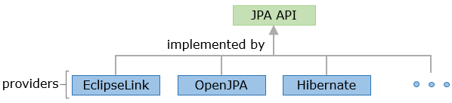
Java Persistence API (JPA)
The Java Persistence API (JPA) is a specification that defines standard for using object relational mapping (ORM) in Java applications for interacting with relational database. It provides :
API to map classes with tables
API for performing CRUD operations
Java Persistence Query Language (JPQL), a querying language for fetching data from database
Criteria API which uses object graph to fetch data from database
There are multiple providers available in market which provides implementation of JPA specification such as EclipseLink, OpenJPA, Hibernate, etc. as shown below:

Slide 12
Defining Entity Classes
The classes which are mapped to a table and whose instance represents a row in table are entity classes. JPA provides annotations to create entity classes which are present in the javax.persistence package. Some of these annotations are as follows:
@Entity : It specifies that the Java class is an entity class.
@Entity
public class Customer {
//rest of the code
}
@Id : Every object of entity class must have an attribute which uniquely identifies it. This is called as primary key attribute or identifier. Usually, it is the attribute mapped to the primary key column of table. It is specified using @Id annotation.

Slide 13
@Entity
public class Customer {
@Id
private Integer customerId;
//rest of the code
}
@Table : It specifies the table with which entity class is mapped. By default, entity class is mapped with a table which has same name as the class name. If entity class has to be mapped with a table whose name is different from class name then, this annotation is used. For example, if CustomerDetails class has to be mapped with customer table then the annotation needs to be used as follows:
@Entity
@Table(name="customer")
public class CustomerDetails {
@Id
private Integer customerId;
//rest of the code
}

Slide 14
@Column : It specifies the name of column in table with which attribute in entity class is mapped. By default, column name is mapped with a column which has same name as the attribute name. If attribute name is different from column name, then this annotation is used. For example, if customerId is to be mapped to customer_id column, then the annotation needs to be used as follows:
@Entity
@Table(name="customer")
public class Customer {
@Id
@Column(name="customer_id")
private Integer customerId;
//rest of the code
}
@Transient : It specifies the attributes which are not stored in table.
Consider the CUSTOMER table given below and its corresponding Customer entity class :

Slide 15
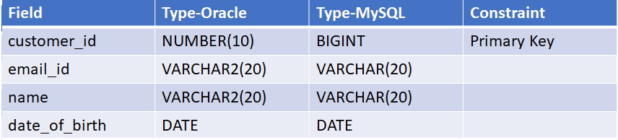


Slide 16
@Entity
public class Customer {
@Id
@Column(name="customer_id")
private Integer customerId;
@Column(name="email_id")
private String emailId;
private String name;
@Column(name="date_of_birth")
private LocalDate dateOfBirth;
//getter and setters
}
In the above code, the name of attributes customerId, emailId and dateOfBirth are different from the column names. So, @Column annotation is used.

Slide 17
Sometimes, entity class has a reference of enum and if you want to persist it, you can use @Enumerated annotation. For example, consider the following Java class which as a reference to CustomerType enum and you have to map it to CUSTOMER table in the database:
public class Customer {
private Integer customerId;
private String emailId;
private String name;
private LocalDate dateOfBirth;
private CustomerType customerType;
//getters and setters
}
public enum CustomerType{
SILVER,GOLD,PLATINUM;
}

Slide 18

CUSTOMER Table:

Slide 19
This can be done using JPA annotations as follows:
@Entity
public class Customer {
@Id
@Column(name="customer_id")
private Integer customerId;
@Column(name="email_id")
private String emailId;
private String name;
@Column(name="date_of_birth")
private LocalDate dateOfBirth;
@Enumerated(EnumType.STRING)
private CustomerType customerType;
//getters and setters
}

Slide 20
In the above code, CustomerType is annotated with @Enumerated annotation. The EnumType property is used to specify how the enum should be persisted in the database.
The possible values of EnumType property are as follows:
@Enumerated(EnumType.STRING) specifies that the enum will be written and read from the corresponding database column as a String. So, customerType set to SILVER will be persisted as SILVER.
@Enumerated(EnumType.ORDINAL) specifies that the enum will be persisted as an integer value. So, customerType set to SILVER will be persisted as 0 and customerType set to GOLD will be persisted as 1. The default is EnumType.ORDINAL.

Slide 21
One of the best practices that should be followed while creating an Entity class is:
Override the equals() and hashCode() methods in the entity classes
The Customer entity class implementation shown to you is sufficient to map it to CUSTOMER table but it is considered as a good practice to override the equals() and hashCode() methods in the entity classes as shown below:
@Entity
public class Customer {
@Id
@Column(name="customer_id")
private Integer customerId;
@Column(name="email_id")
private String emailId;
private String name;
@Column(name="date_of_birth")
private LocalDate dateOfBirth;
@Enumerated(EnumType.STRING)
private CustomerType customerType

Slide 22
//getter and setters
@Override
public int hashCode() {
final int prime = 31;
int result = 1;
result = prime * result + ((this.getCustomerId() == null) ? 0 : this.getCustomerId().hashCode());
return result;
}
@Override
public boolean equals(Object obj) {
if (this == obj)
return true;
if (obj == null)
return false;
if (getClass() != obj.getClass())
return false;
Customer other = (Customer) obj;
if (this.getCustomerId() == null) {
if (other.getCustomerId() != null)
return false;
}
}

Slide 23
NOTE : The implementation of equals() and hashCode() methods will change based on the requirements.
Why overriding equals() and hashCode() methods in entity class is considered to be a good practice?
This is because each instance of an entity class represents a row in database and in real time, you may have many objects of this class. So, you need to differentiate one object from the other. JPA ensures that there is a unique instance for each row of the database but if you want to store the objects in a Set, then you need to override equals() and hashCode() methods.

Slide 24
A best practice that should be followed in mapping an Entity class is:
Avoid database tables associated to more than one entity, i.e., one single table in the database should be associated with only one entity
While mapping entity classes and the database tables, it is advised to avoid database tables associated to more than one Entity. i.e; one single table in the database should be associated with one single entity.
What can be the possible reason for this?
Consider a scenario where two entities are mapped to the same database table.
The problem arises because Hibernate doesn’t know which entity represent the same database record. The disadvantage here is that, developers have to make sure they don’t fetch more than one entity type for the same database table record. Otherwise, this can cause inconsistencies when flushing the persistence context. Hibernate doesn’t refresh any of these entities if we update the other one as it handles them independently.
In such cases, review your design and decide which Entity must manage the table.
Thus, as a best practice while mapping an Entity to a database table, avoid tables associated to more than one Entity.

